Slide 1
E. Coli Prediction in UK Water Quality Data
By Andrew Lien
July 2018
Springboard Introduction to Data Science Course

Slide 2
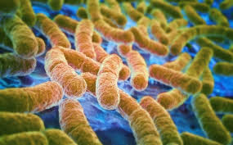
Introduction
E. coli outbreaks have been known to be a public health concern; one of the pathways e. coli is contracted is by swimming in bodies of water with unsafe e. coli concentrations.
To minimize the number of e. coli incidents, warnings are issued by the UK Environmental Health Agency when levels surpass a safe concentration of 900 cfu/100ml (1). A limitation of this warning is that the biological test for measuring the concentration of e. coli takes around 24 hours.
Proposal: In order to get a quicker warning, this project aims to get a faster e. coli prediction based on the results of chemical tests that are faster to complete than the 24 hour biological test.

Slide 3
Approach
This project combines water quality data from the UK Environmental Agency (2) for the years 2013 – 2017. This is wrangled into a tidy format using R packages “tidyr” and “dplyr”.
This is then explored using various visualization techniques to find correlations and relationships between each variable and e. coli concentration.
Using the identified significant variables, a predictive model can be created to anticipate whether a body of water will have an e. coli concentration above the 900 cfu/100ml benchmark.

Slide 4

Data Structure
To make the data manageable, unnecessary columns are removed. The remaining columns are:
time
determinand.label
result
resultunit
materialtype
easting
northing

Slide 5
Data Wrangling
Filtering: because the combined data set is large (>13 GB), material types and determinands are filtered out based on frequency of occurrence, relevance to e. coli growth, and relevance to public safety.
Tidying: A tidy data set is one in which each column is a variable and each row is an observation (3). The original dataset has multiple tests performed at the same time, place, and material type included in the same column, “result”. This is converted into tidy format using the functions “spread()” and “aggregate()”.

Slide 6
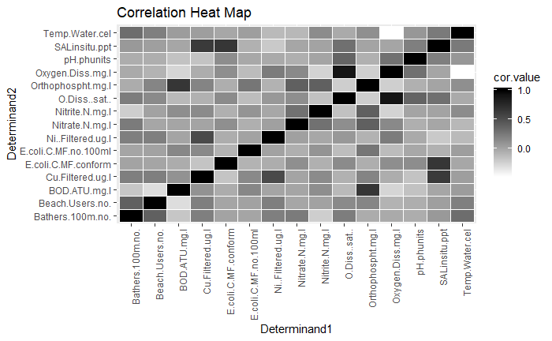
Exploratory Analysis: Correlation Matrix Heat Map
This shows which variable pairs are related and focuses the scope of the investigation to several relationships:
SALinsitu.ppt and E.coli.C.MF.conform
Oxygen.Diss.mg.l and Temp.Water.cel
Oxygen.Diss.mg.l and O.Diss..sat..
These relationships are given priority when testing new predictive models.

Slide 7
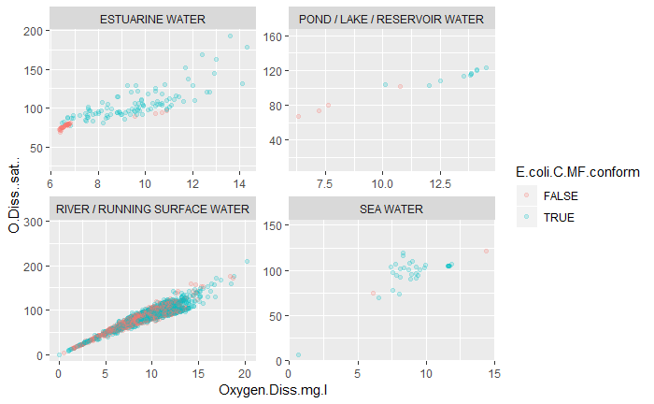
Exploratory Analysis: Excluding O.Diss..sat..
As seen by the strong positive correlation between Oxygen.Diss.mg.l and O.Diss..sat.., only one of these variables need to be kept to create a predictive model. Given that both of these variables are measures of the same physical property, the amount of oxygen dissolved in water, this conclusion makes sense. O.Diss..sat.. can then be removed from the data set.

Slide 8
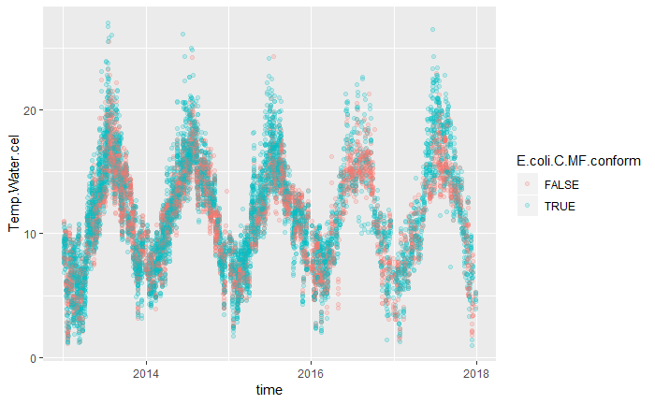
Exploratory Analysis: Relationships with Time
Given that water temperature has an effect on e. coli growth, the oscillating pattern of water temperature when plotted against time suggests that e. coli concentration in water may have a seasonal pattern. This is tested in modeling.

Slide 9
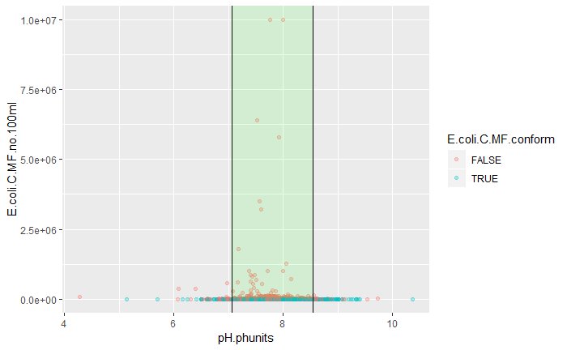
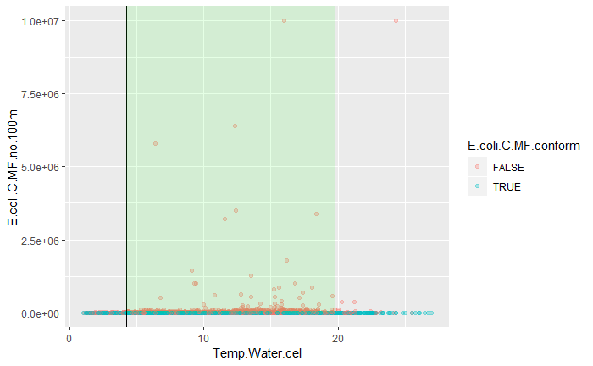
Feature Engineering
Some variables need to be modified before they can be useful to a predictive model. Three features were engineered:
Seasons: the 12 months are blocked into 4 categories, one per season.
pH.ecolirange: this is TRUE/FALSE of whether the value is within 2 standard deviations of the mean.
temp.ecolirange: this is TRUE/FALSE of whether the value is within 2 standard deviations of the median.

Slide 10
Baseline Model (model0)
The baseline model is created using the Zero Rule Algorithm (4), which predicts the class value that is most common in the training set. For this project, because there are more instances of water samples conforming to the e. coli concentration limit of 900 cfu/100ml, this model assumes that all samples are conforming. A confusion matrix displaying the results is shown to the right.
Accuracy = 0.784 False Positive Rate = 1
Objective: minimize false positive rate
 | FALSE (Predicted) | TRUE (Predicted)
FALSE (Actual) | 0 | 8360
TRUE (Actual) | 0 | 30366

Slide 11
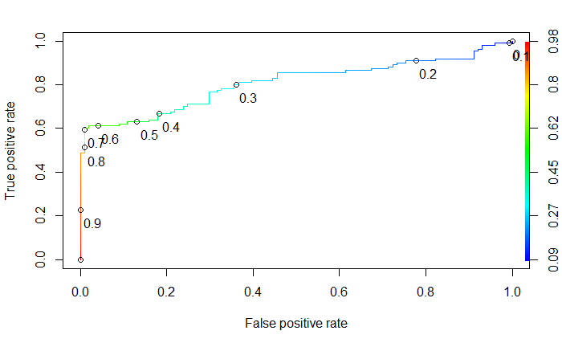
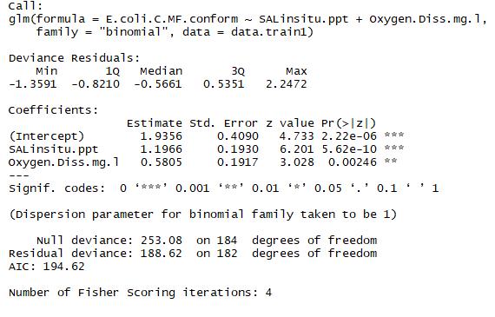
model1 [SALinsitu.ppt + Oxygen.Diss.mg.l]
 | FALSE (Predicted) | TRUE (Predicted)
FALSE (Actual) | 100 | 1
TRUE (Actual) | 45 | 66

Slide 12
Comparing model0 and model1
Model | Test size | AUC of ROC | Sensitivity | False Positive Rate | F1-score | Accuracy
Model0 | 38726 | 0 | 1 | 1 | 0.879 | 0.784
model1 | 212 | 0.808 | 0.595 | 0.010 | 0.742 | 0.783
False Positive Rate: As the most important comparison metric that prevents e. coli exposure, the false positive rate is significantly lower in model1 than in model0, so this is a huge improvement.
Accuracy: relatively unchanged. Higher accuracy is better, but is not the main emphasis of this project.
By comparing different numerical metrics of the models, it’s possible to find the most suitable one for the problem.

Slide 13
Comparison of All Models
Composition of Models
model0 = [Zero-Rule Algorithm]
model1 = [SALinsitu.ppt + Oxygen.Diss.mg.l]
model2 = [SALinsitu.ppt + Oxygen.Diss.mg.l*season]
model3 = [SALinsitu.ppt + Oxygen.Diss.mg.l + pH.ecolirange + temp.ecolirange]
model4 = [SALinsitu.ppt]
Model | Test size | AUC of ROC | Sensitivity | False Positive Rate | F1-score | Accuracy
model0 | 38726 | 0 | 1 | 1 | 0.879 | 0.784
model1 | 212 | 0.808 | 0.595 | 0.010 | 0.742 | 0.783
model2 | 212 | 0.826 | 0.595 | 0.010 | 0.742 | 0.783
model3 | 173 | 0.737 | 0.347 | 0.020 | 0.505 | 0.717
model4 | 25379 | 0.932 | 0.922 | 0.131 | 0.952 | 0.916

Slide 14
Results
model1 and model2 have the lowest false positive rates of 0.010, so are better than the others.
model2 has one more variable than model1 (season) but has the exact same confusion matrix and comparison metrics, so model1 is better than model2 because it avoids overfitting.
model1 can be used to predict whether a water sample has an e. coli concentration above 900 cfu/100ml with a 78.3% accuracy and a 1% false positive rate.

Slide 15
Conclusions
Application
Both salinity and dissolved oxygen are physical properties of water than can be tested quickly and simply, allowing for same-day results that can predict whether e. coli levels in a body of water will be unsafe. This model should be applied to bodies of water commonly used to guard public health by giving advance e. coli warnings.
Limitations
Not all tests were performed on each sample, limiting the number of samples that had all variables of interest tested. This limited the number of observations in the data set, and, in order to not diminish the data set size by too much, the number of variables included in the model as well.
Recommendations for Future Work
Since salinity and dissolved oxygen are the major predictors for high e. coli levels, these two tests should be performed on all bodies of water that people may swim in.
Apply the process of data munging, exploratory analysis, and modeling to other locations outside the UK. An interesting study would be to see what the predictor variables are for other locations.

Slide 16
References
https://environment.data.gov.uk/bwq/profiles/help-understanding-data.html
http://environment.data.gov.uk/water-quality/view/landing
Wickham, Hadley (20 February 2013). “Tidy Data”. Journal of Statistical Software.
https://machinelearningmastery.com/implement-baseline-machine-learning-algorithms-scratch-python/

